Slide 1
Predictive Intelligence System for Cholera
Using Earth Observations
Dr. Antar Jutla,
University of Florida

Slide 2
Introduction/Background
Why Prediction?
Intervention Point
Intervention Point
Incidence
Incidence
Week
Week
Scenario A
Scenario B
Schematic representation of the disease control measures implemented at the beginning (Scenario A) and after the peak (Scenario B) of an outbreak, and potential cases averted.

Slide 3
Introduction/Background
Timeline of Cholera Prediction to Current Stage

Slide 4
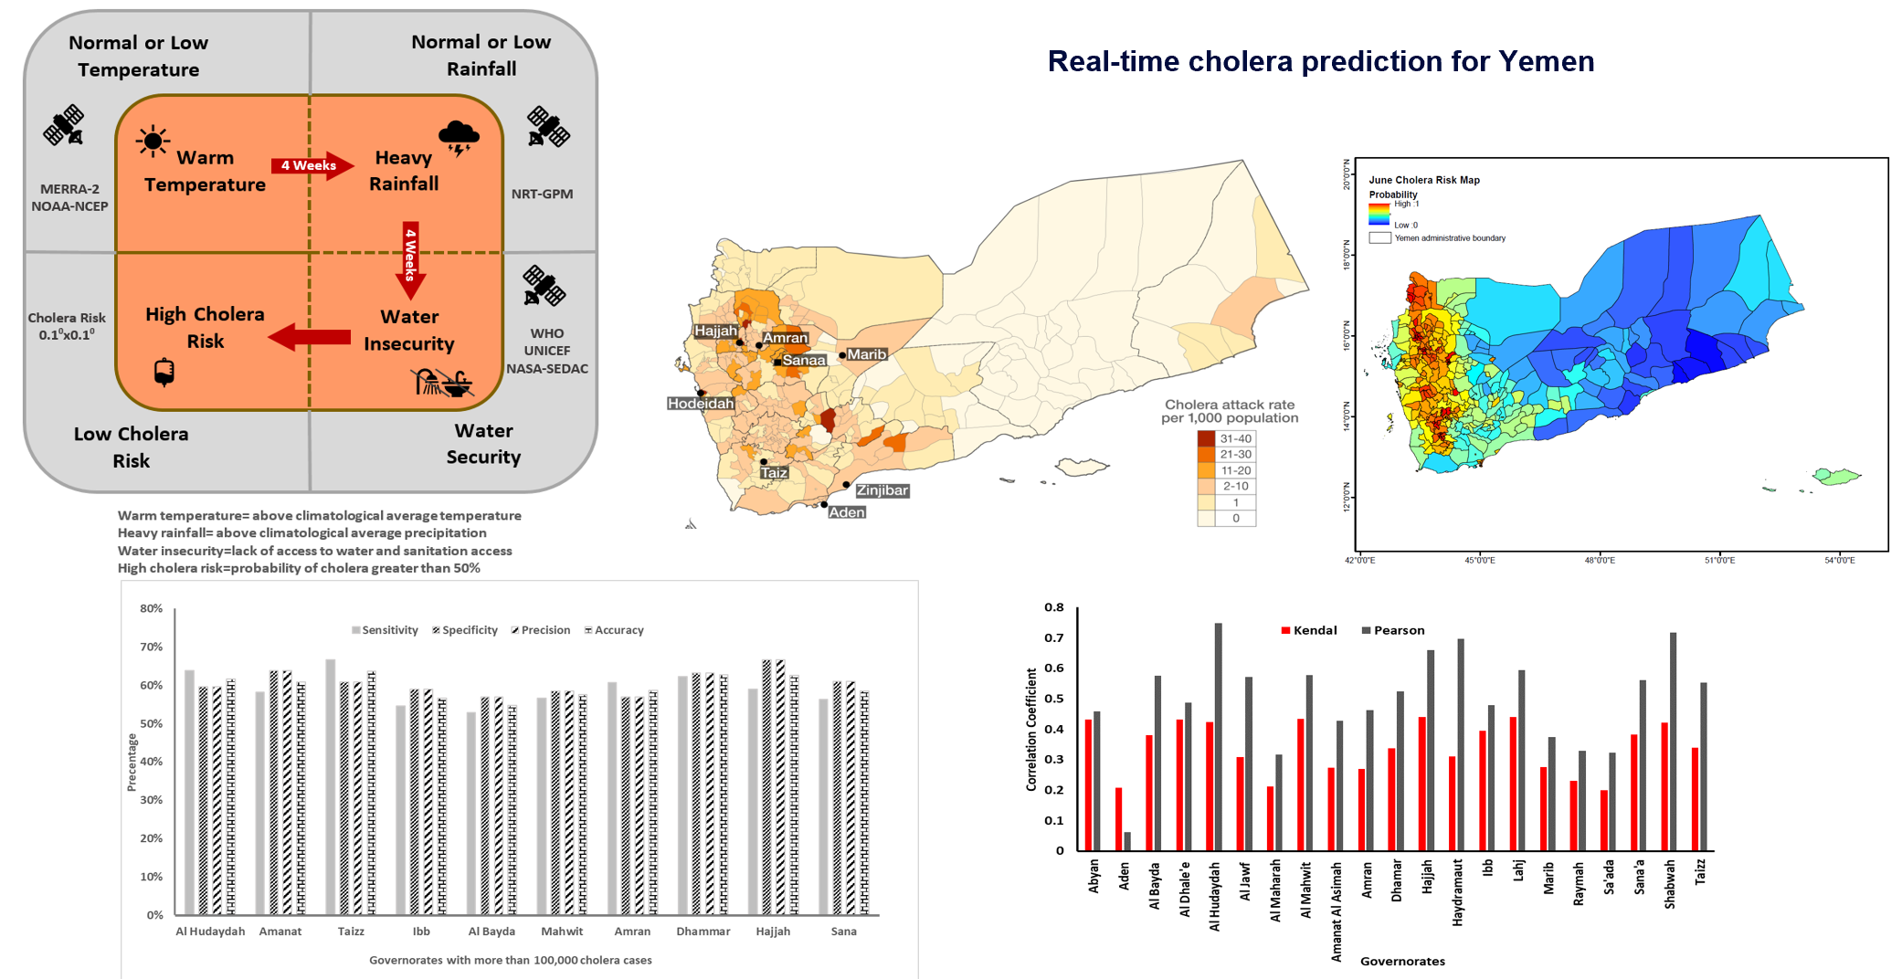
Method and Results
Usmani, et al (accepted, Nature-Scientific Reports)

Slide 5
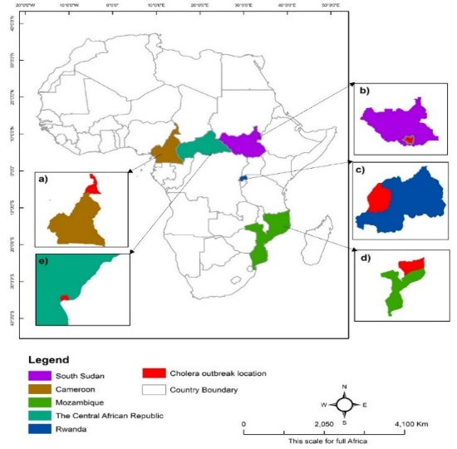
Results- and Validation
Country | Region (Case Fatality Ratio) | Tprob (Two month lead) | Pprob (One month lead) | Societal disturbance
South Sudan | Juba (5%) | 0.021 (Feb 14) | 0.005 (March 14) | Civil unrest
Central African Republic (CAR) | Mongoumba (13%) | <0.001 (July 11) | 0.101 (August 11) | Natural Hazard (Floods)
Rwanda | Rutsiro(50%) | <0.001 (Sept 12) | <0.001 (October 12) | Natural Hazard (Floods)
Cameroon | Nord Region (13%) | 0.012 (July 09) | 0.023 (August 09) | Natural Hazard (Floods)
Mozambique | Delgado(1%) | <0.001 (Dec 12) | 0.002 (January 13) | Natural Hazard (Floods)
Jutla et al., PLOS 2015

Slide 6
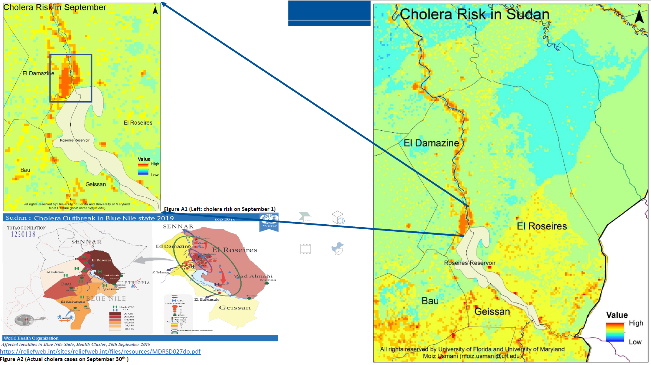
Final or Preliminary Results/Outputs

Slide 7
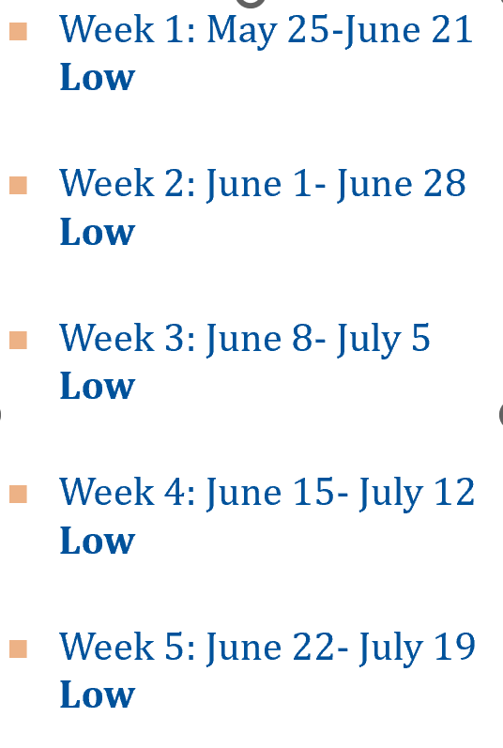
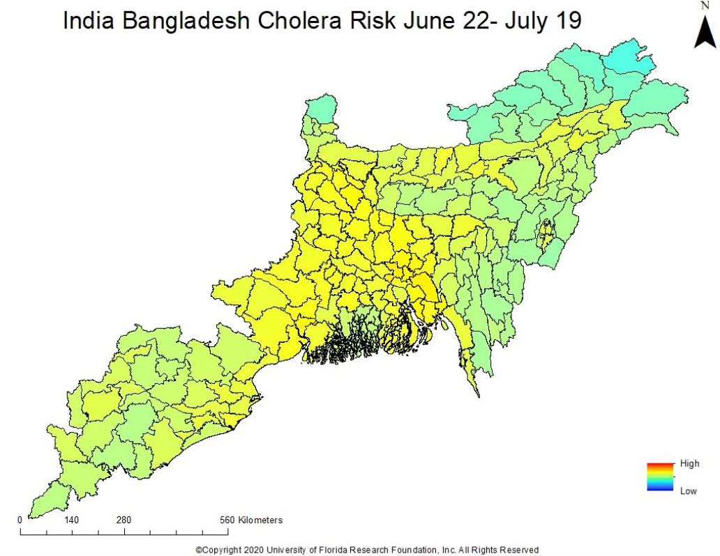
Results- Validation

Slide 8
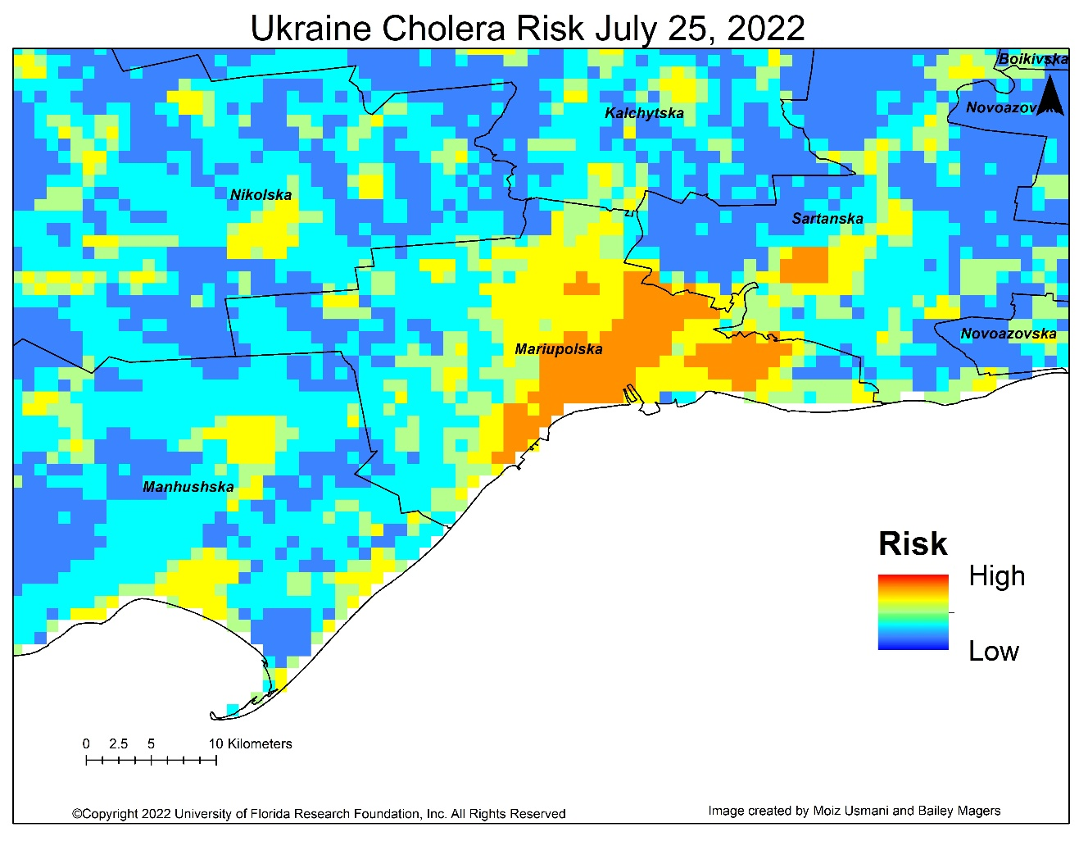
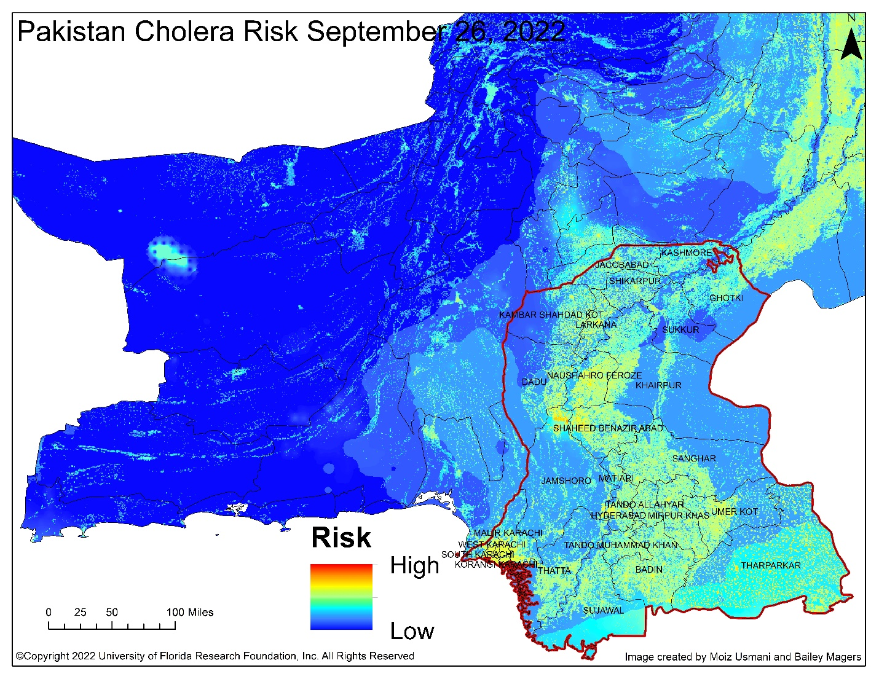
Results- Validation

Slide 9
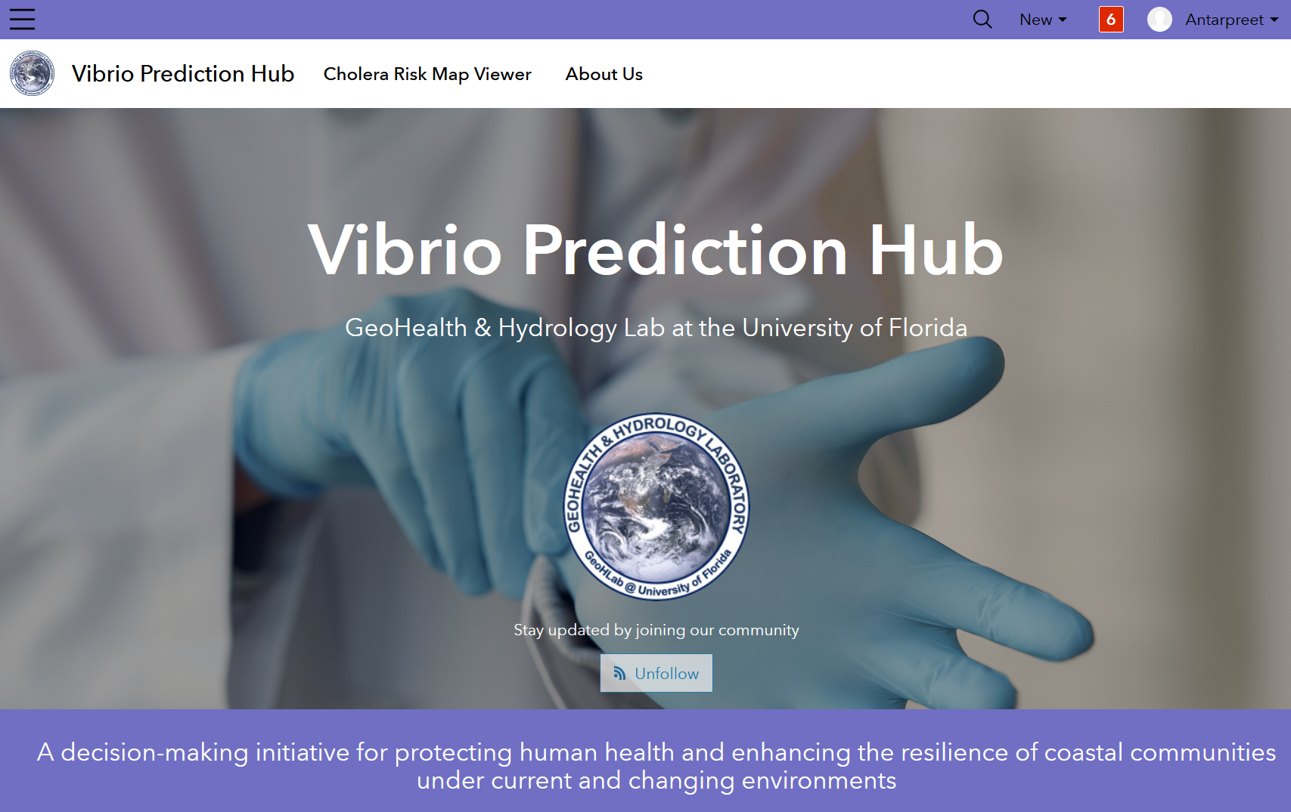
Stakeholder Participation
https://vibrio-prediction-ufl.hub.arcgis.com/

Slide 10
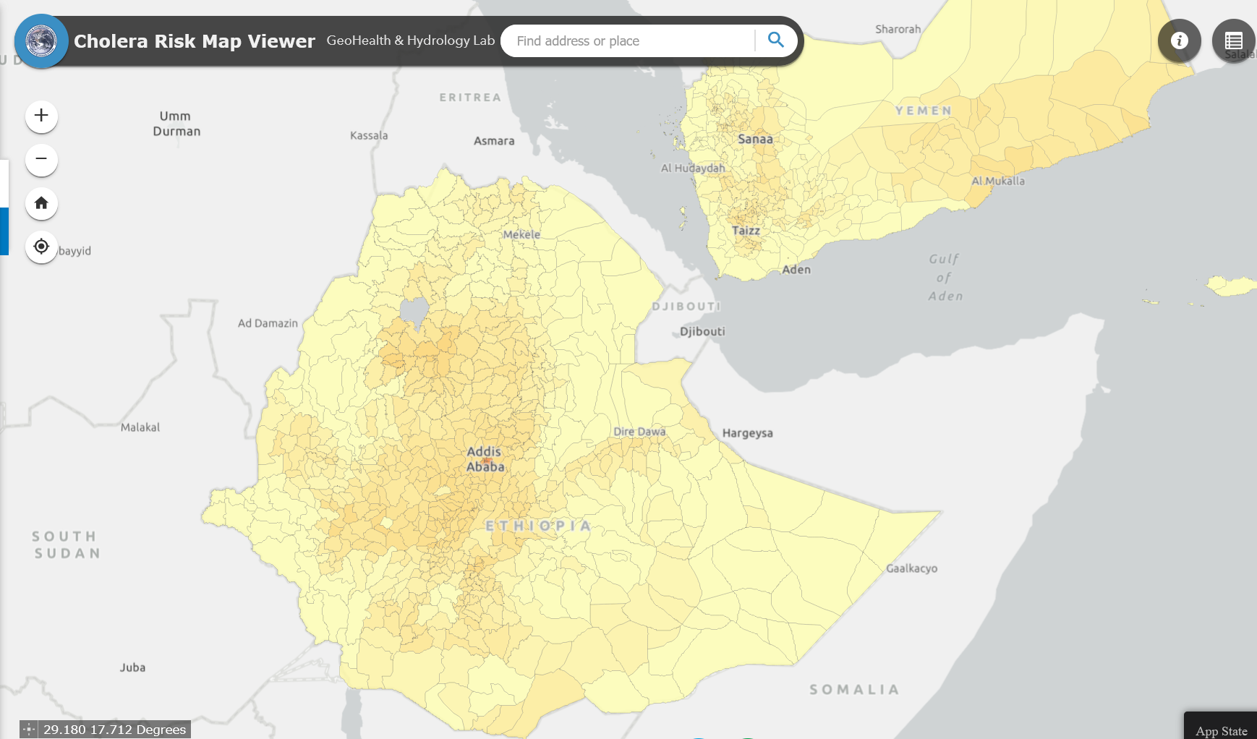
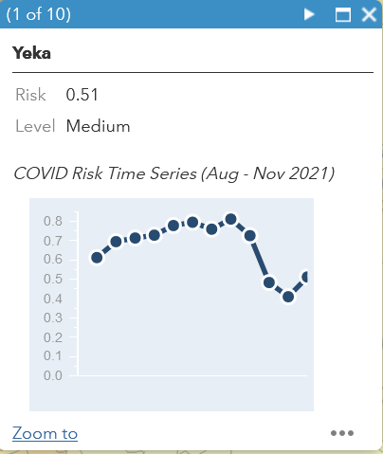
Stakeholder Engagement

Slide 12
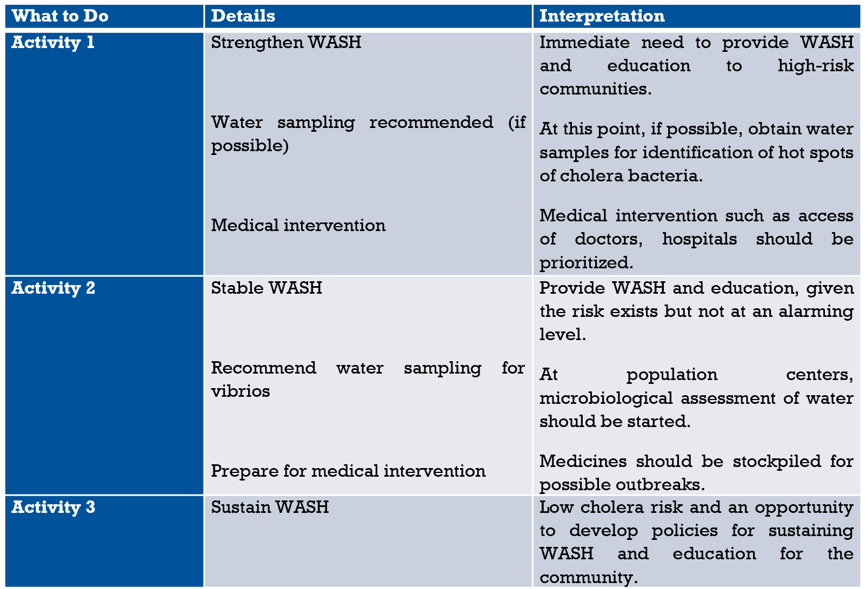

Slide 13
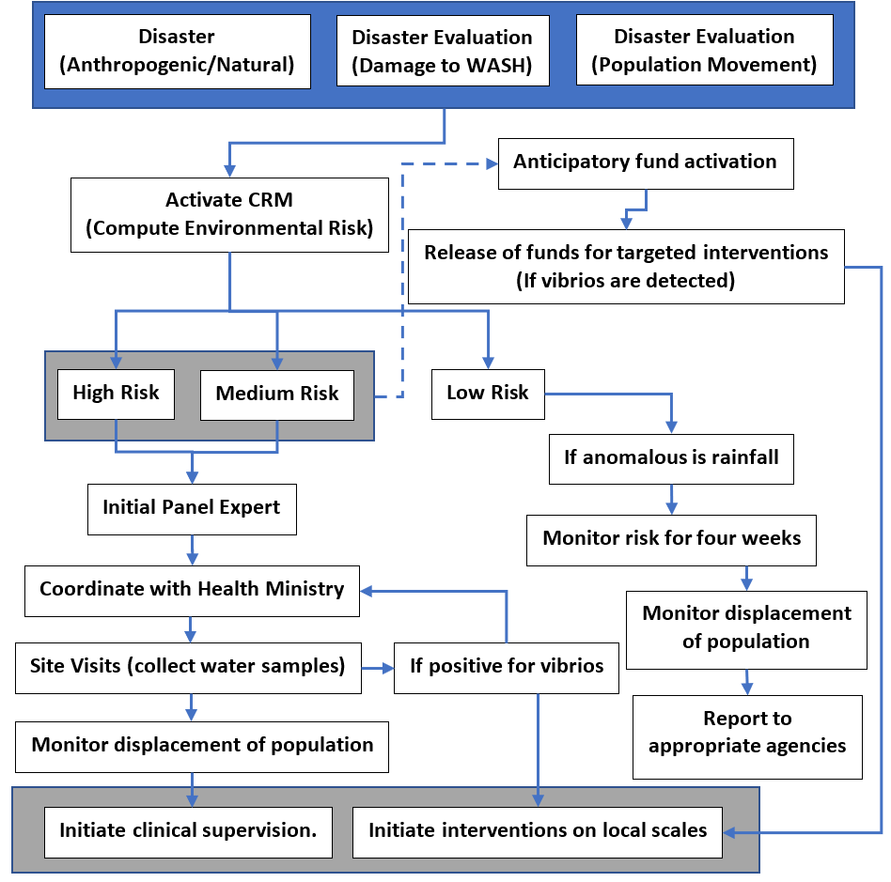
Anticipatory Decision Making
Cholera Risk Modeling Strategy
Usmani, et al (under review)

Slide 14
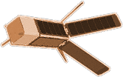
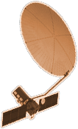
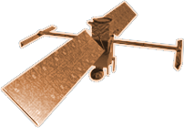
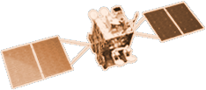
2015-2019 Prototype of cholera prediction models
NISTAR, EPIC
2015
CYGNSS (8)
GRACE-FO (2)
SMAP
2013 Classification of modes of cholera
ICESAT-2
OCO-2
2020
2020s Real-time regional cholera prediction
GPM
SENTINEL-6
MICHAEL FREILICH
EARTH FLEET
GEDI
LANDSAT 8
LANDSAT-9
EMIT
1990s Colwell’s vibrios hypothesis
SUOMI NPP
INVEST/CUBESATS
ECOSTRESS
SeaWiFS
CSIM-FD 2023
HARP 2022
CIRIS 2023
CTIM* 2022
HYTI* 2022
SNOOPI* 2022
NACHOS* 2022
NACHOS2* 2022
TROPICS (6)
1995
2010
OCO-3
LANDSAT 7
CALIPSO
NISAR
AQUA
CLOUDSAT
SWOT
CLARREO-PF
AURA
2000
JPSS INSTRUMENTS
TSIS-1
2005
GEOCARB
LIS
2001 Lobitz chlorophyll study
OMPS-LIMB 2022
LIBERA 2027
TEMPO
SAGE III
2020s FUTURE: Coastal/ Oceanic movement of vibrios; Shifts in ecological niches
PREFIRE (2)
MAIA
ISS INSTRUMENTS
KEY
PACE
INTERNATIONAL PARTNERS
U.S. PARTNER
ISS INSTRUMENT
JPSS INSTRUMENT
CUBESAT
LAUNCH DATE TBD
TSIS-2
GLIMR
ESO-1, 2, 3, 4
PREFORMULATION
FORMULATION
OPERATING
EXTENDED
SENTINEL-6B
MISSIONS
10.13.21
2025

Slide 15
Acknowledgement
Thank you
Dr. Moiz Usmani, University of Florida
Dr. Rita Colwell, University of Maryland
Dr. Ali Akanda, University of Rhode Island
In consultation with
Juan Chavez Golzalez, UNOCHA
UK FCDO

Slide 16
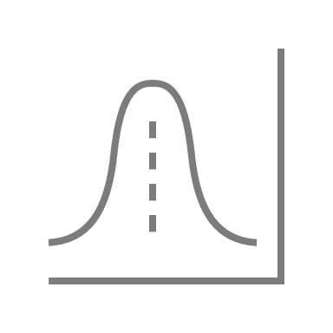
Cholera
Ancient water-borne disease
Modes
Epidemic
Endemic
Mechanism
Trigger
Transmission
Trigger
Transmission
Coastal Ecology
River flows
Epidemics
Temperature
Precipitation
Water bodies
Damage to WASH
Changes in human behavior
Damage to WASH
Impacts
Expected behavior
Anticipated seasonal preparedness
Low mortality rates
Population unprepared for vibrios
Seasonality is not observed
Massive mortality rates

Slide 17
https://www.youtube.com/watch?v=YTXNP9a2aes

Slide 18
https://www.youtube.com/watch?v=YTXNP9a2aes

